Slide 1
Go GC策略分享
张凯宏

Slide 2
Agenda
Overview
Features in Go
History
Generational GC
Go Going Forward

Slide 3
GC’s View of Go

Slide 4
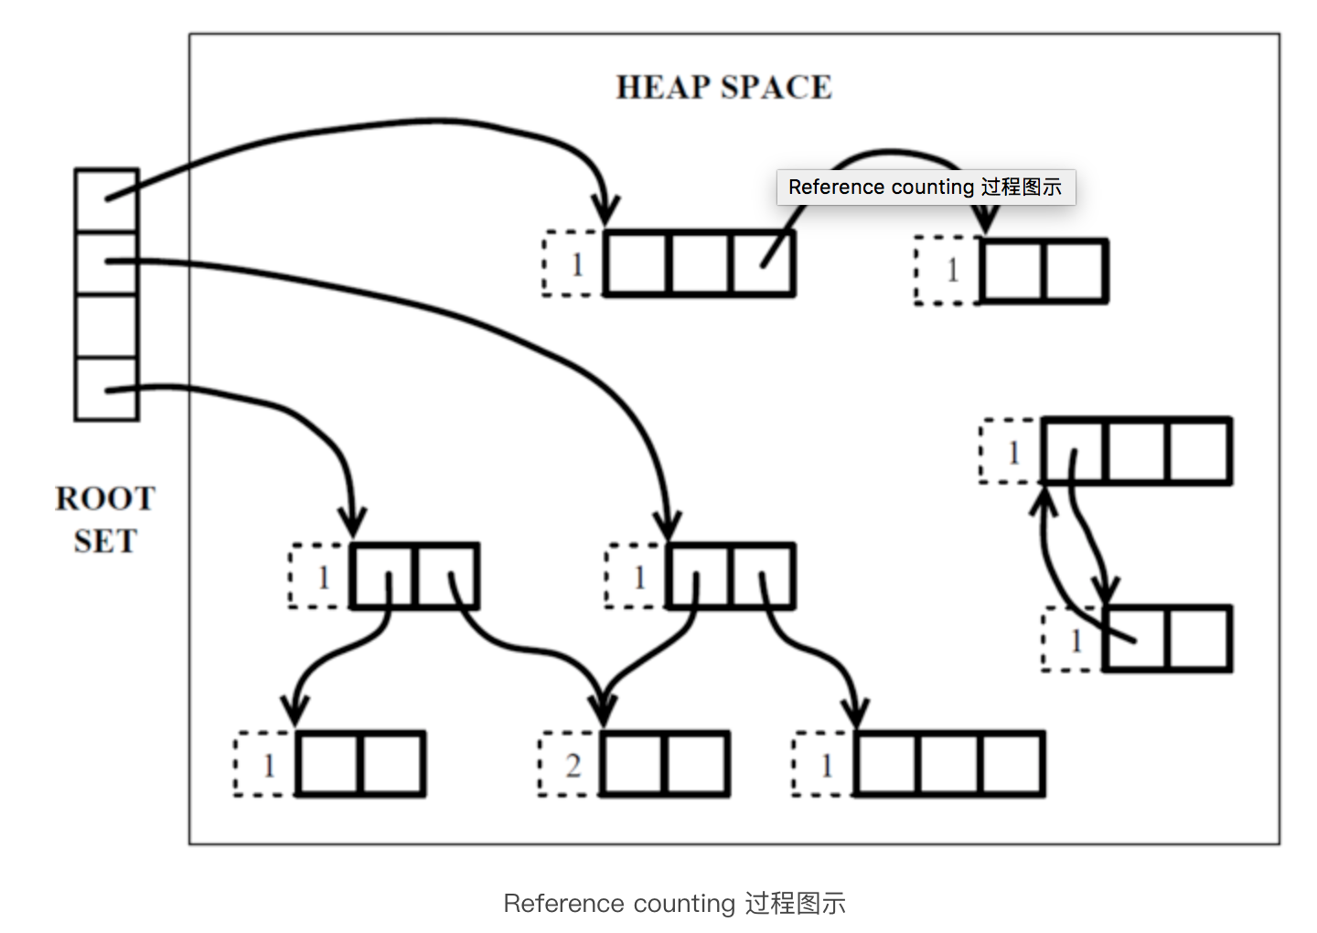
引用计数（RC）

Slide 5
引用计数
无法解决循环引用
实现一个高效率的引用计数 GC 比较困难
space overhead，每个对象需要额外的空间来存储其引用次数
speed overhead，在增加/减少对象的引用时，需要修改引用次数。这对于栈上的赋值（on-stack assignment，比如函数调用是的参数、函数内部变量等）影响是非常大的，因为之前只需要简单修改寄存器里面的值，现在需要一个原子操作（这涉及到加锁，会浪费几百个 CPU cycles）
减少一个对象的引用计数时，会级联减少其引用对象的计数，这就可能造成同时删除过多的对象。

Slide 6
Mark - Sweep

Slide 7
Mark - Sweep
mark，从 root 开始进行树遍历，每个访问的对象标注为使用中
sweep，扫描整个内存区域，对于标注为「使用中」的对象去掉该标志，对于没有该标注的对象直接回收掉

Slide 8
Mark - Sweep缺点
在进行 GC 期间，整个系统会被挂起（暂停，Stop-the-world），所以在一些实现中，会采用各种措施来减少这个暂停时间
heap 容易出现碎片。实现中一般会进行 move 或 compact。（需要说明一点，所有 heap 回收机制都会这个问题）
在 GC 工作一段时间后，heap 中连续地址上存在 age 不同的对象，这非常不利于引用的本地化（locality of reference）
回收时间与 heap 大小成正比

Slide 9
Features in Go

Slide 10
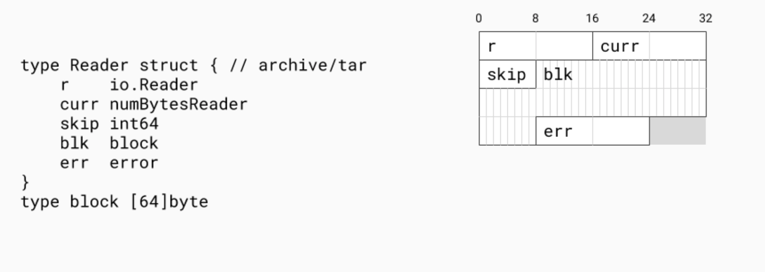
Go is value-oriented

Slide 11
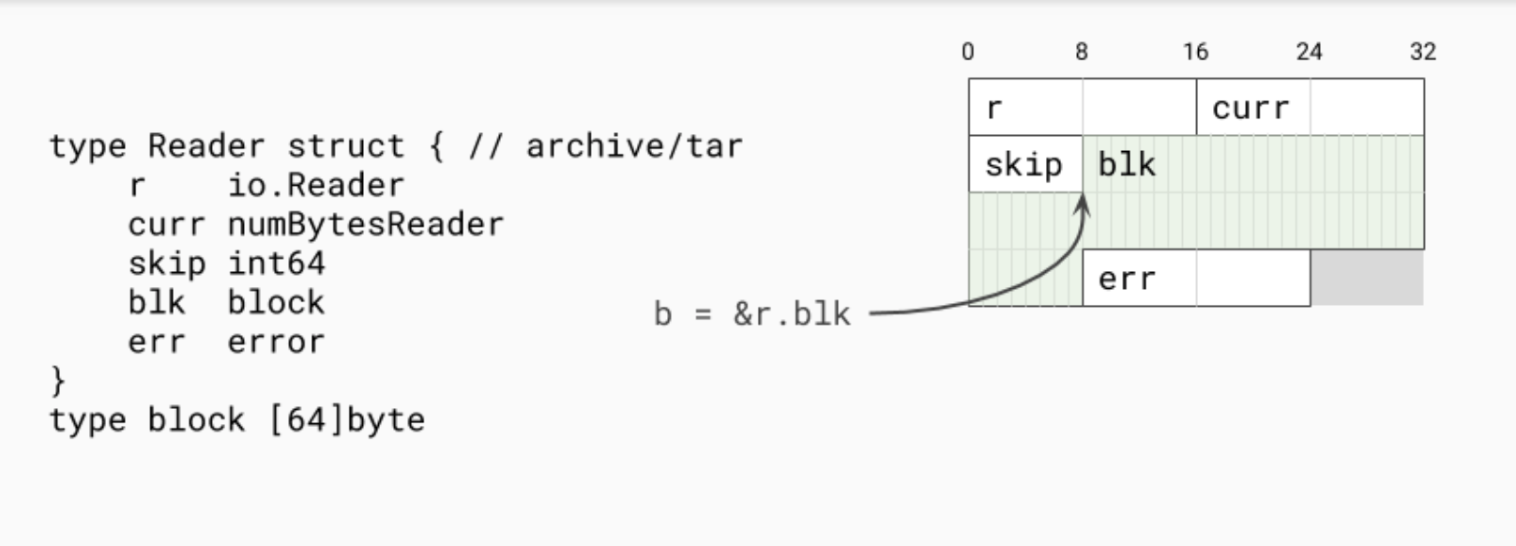
Go allows interior pointers

Slide 12
静态编译
No JIT recompilation
优势：reproducibility of program execution is a lot easier which makes moving forward with compiler improvements much faster
劣势：On the sad side of it we don't have the chance to do feedback optimizations as you would with a JITed system
Binary contains entire runtime

Slide 13
Two GC knobs
SetGCPercent: Adjusts how much CPU you want to use and how much memory you want to use. The default is 100 which means that half the heap is dedicated to live memory and half the heap is dedicated to allocation.
SetMaxHeap: Set what the maximum heap size should be

Slide 14
History

Slide 15
2014 – GC latency is an existential threat
> 100ms p99 latency
One request may suffer several GCs
It's 2014 and Jeff Dean had just come out with his paper called 'The Tail at Scale' which this digs into this further.
This problem is called the tyranny of the 9s

Slide 16
Fight the tyranny of the 9s with redundancy
多部署几个节点
一旦一个节点超时，则请求下一个节点

Slide 17
Fight the tyranny of the 9s with redundancy

Slide 18
2014 GC SLO
25% of the total CPU
Heap 2X live heap
10ms STW pause every 50ms
Goroutine allocation ~= GC assists

Slide 19
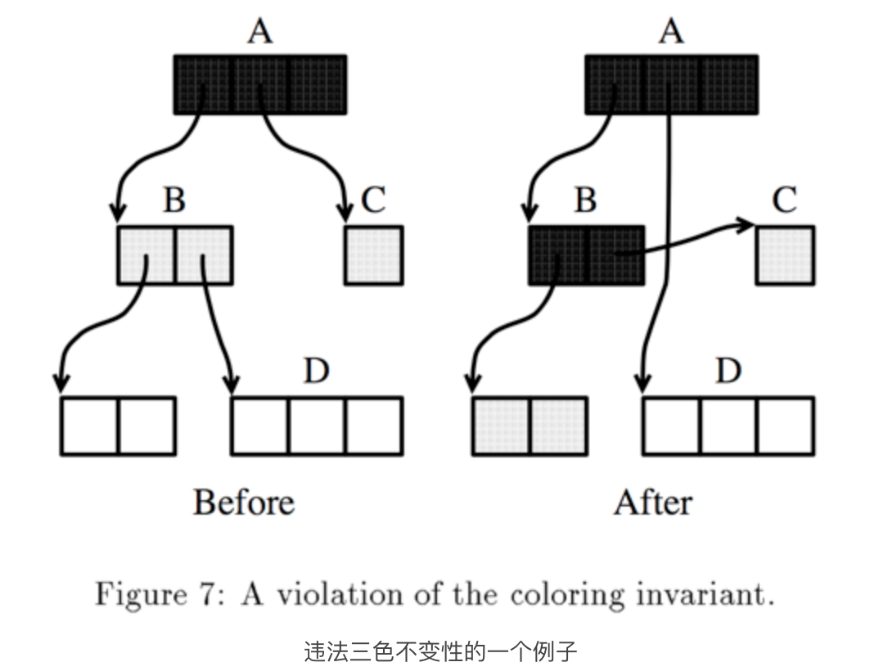
Tri-color algorithm and Write barrier
三色标记法过程中，如果黑色节点引用白色节点，则可能会错误地回收白色节点。
解决方案：写屏障，记录下 mutator 新增的由黑色–>白色对象的指针，并把该对象标为灰色

Slide 20
Copying GC and Read Barrier
Copying GC：解决GC中内存碎片问题，且在分配内存时可以使用Bump the pointer算法（尾指针就地分配）
Read Barrier：解决Copying过程中，读到旧对象问题。在读的时候加个判断，如果正在copy，则等待copy完成后再读。

Slide 21
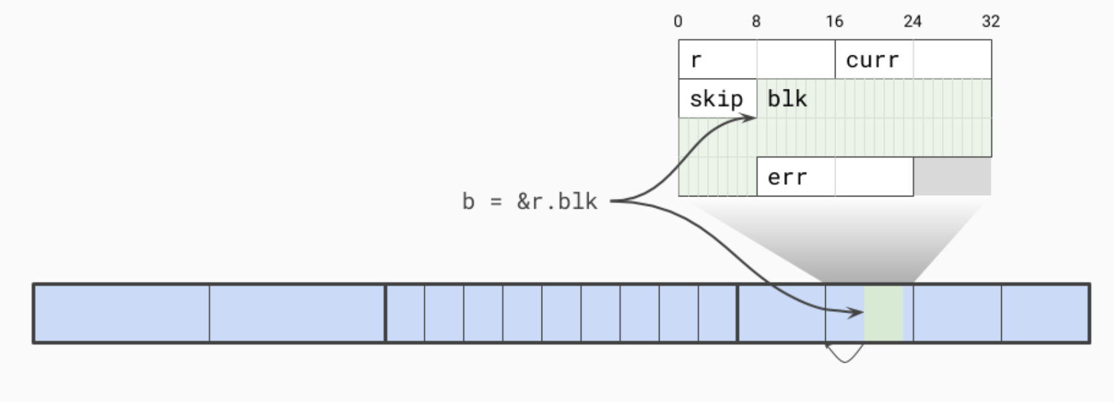
Size-segregated spans

Slide 22
Size-segregated spans
类似tcmalloc（google），jemalloc，written in Go
Low Fragmentation
Zero contention allocation paths among Goroutines
Speed: Non-copy did not concern us, allocation admittedly might be slower but still in the order of C. It might not be as fast as bump pointer but that was OK.

Slide 23
Object Metadata
No Headers in pointer
On-the-side mark bit, reused for allocation
Each word has 2 bits:
Pointer or scalar
More pointers in object

Slide 24
Write barrier on during GC
The write barrier is on only during the GC
At other times the compiled code loads a global variable and looks at it
Write barrier is responsible for ensuring that no reachable objects get lost during the tri-color operations

Slide 25
The GC Pacer
Monitor the marking progress and ensure allocation doesn't overrun the concurrent marking
The Pacer slows down allocation while speeding up marking
Stop the Goroutine, which is doing a lot of the allocation, and puts it to work doing marking
Speed up the garbage collector while slowing down the mutator

Slide 26
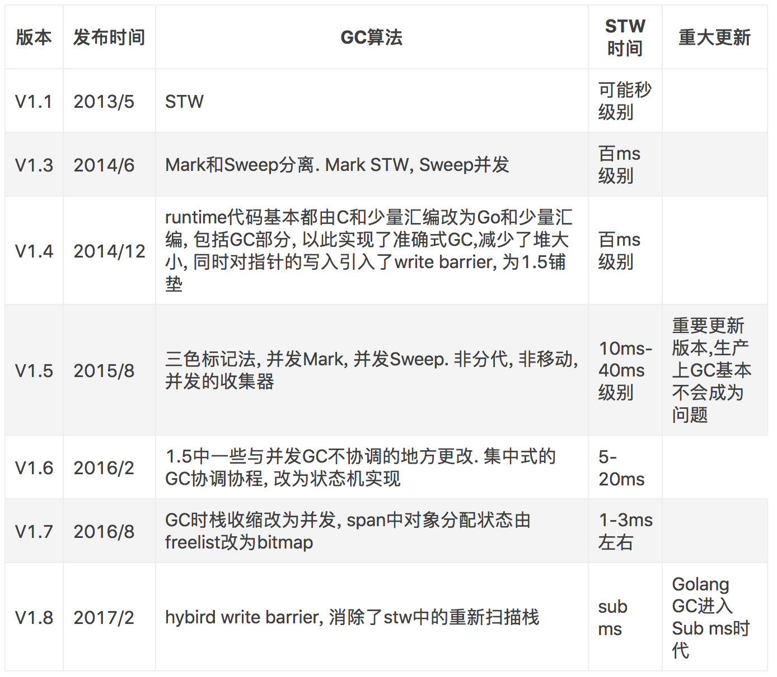
GC History

Slide 27
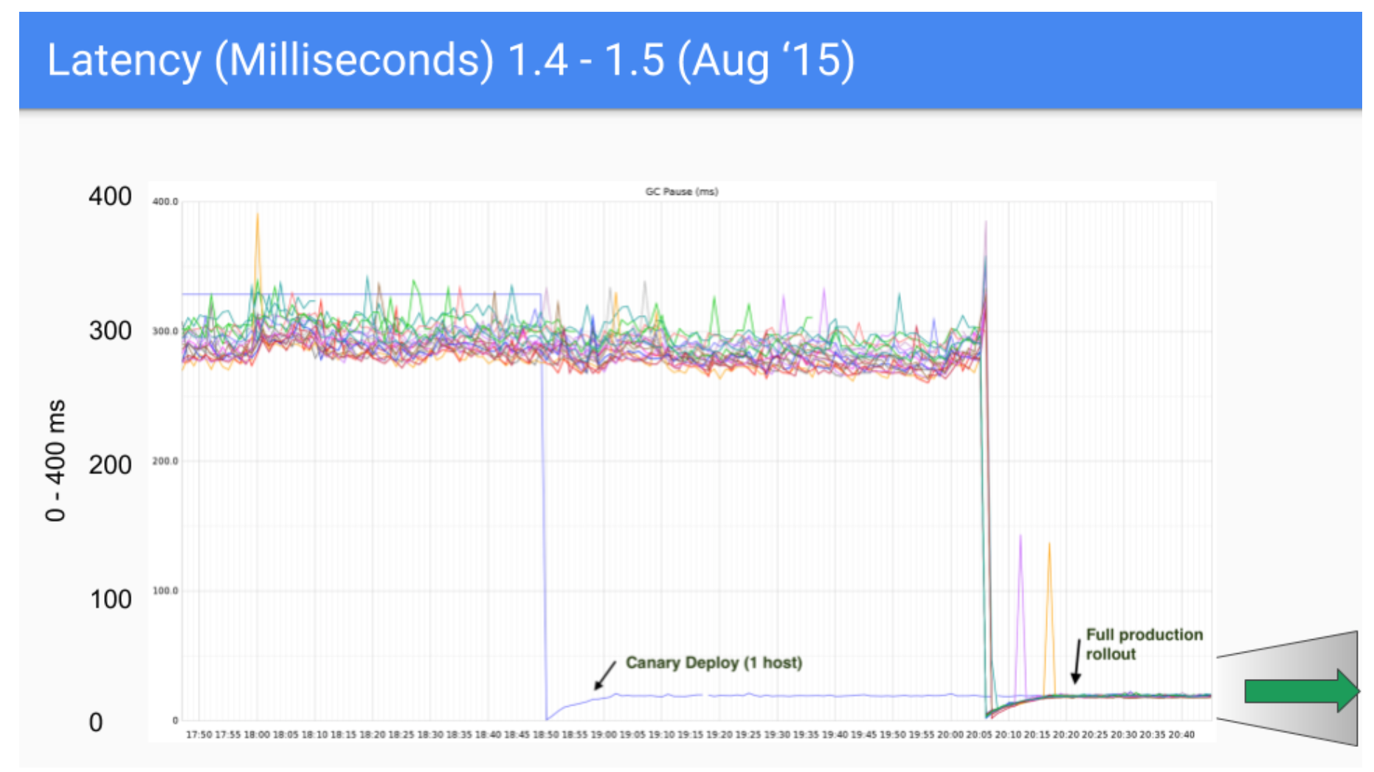
Latency: 1.4 – 1.5

Slide 28
Latency: 1.5 – 1.6

Slide 29
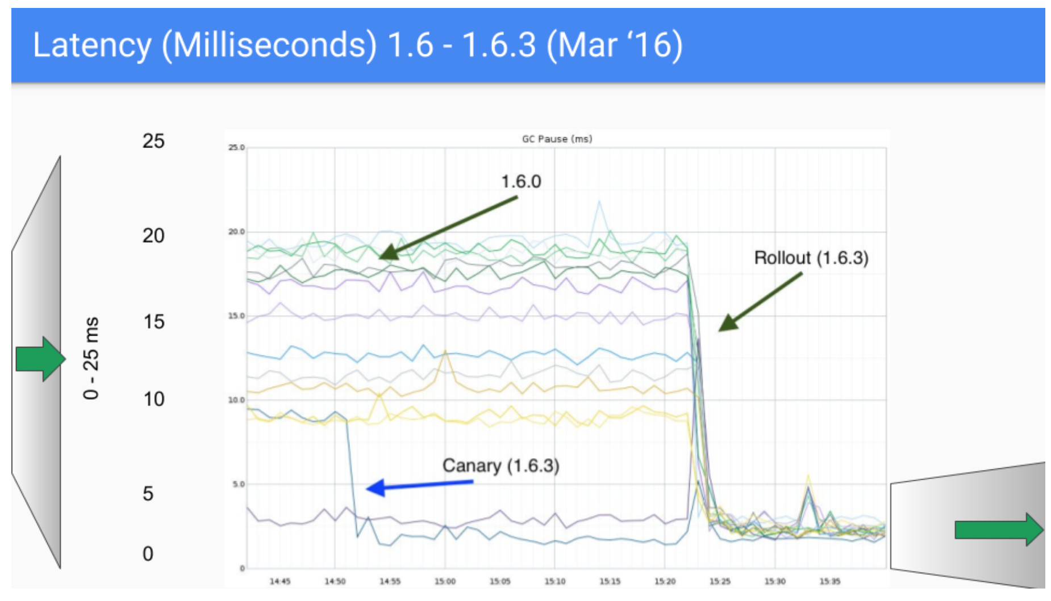
Latency: 1.6 – 1.6.3

Slide 30
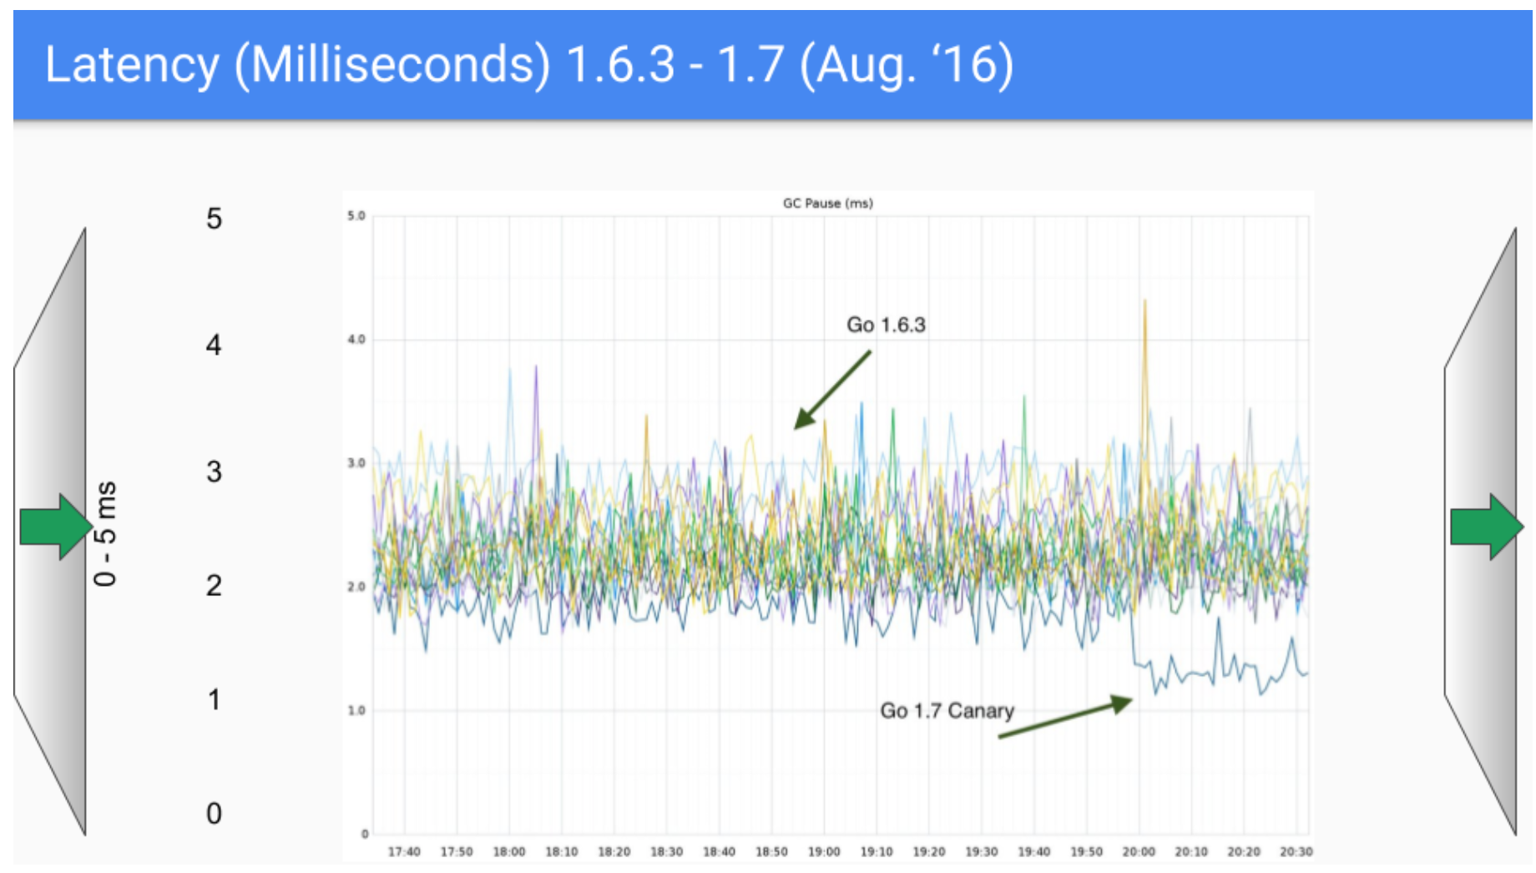
Latency: 1.6.3 – 1.7

Slide 31
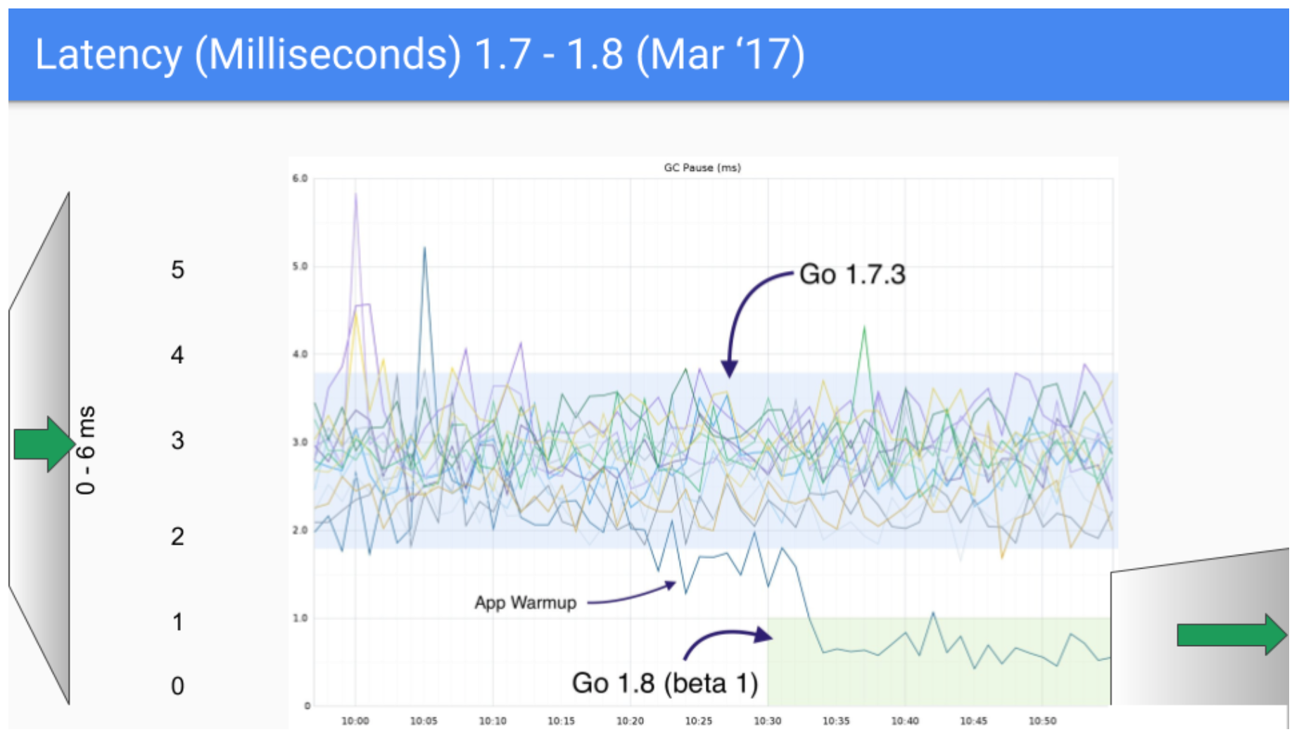
Latency: 1.7 – 1.8

Slide 32
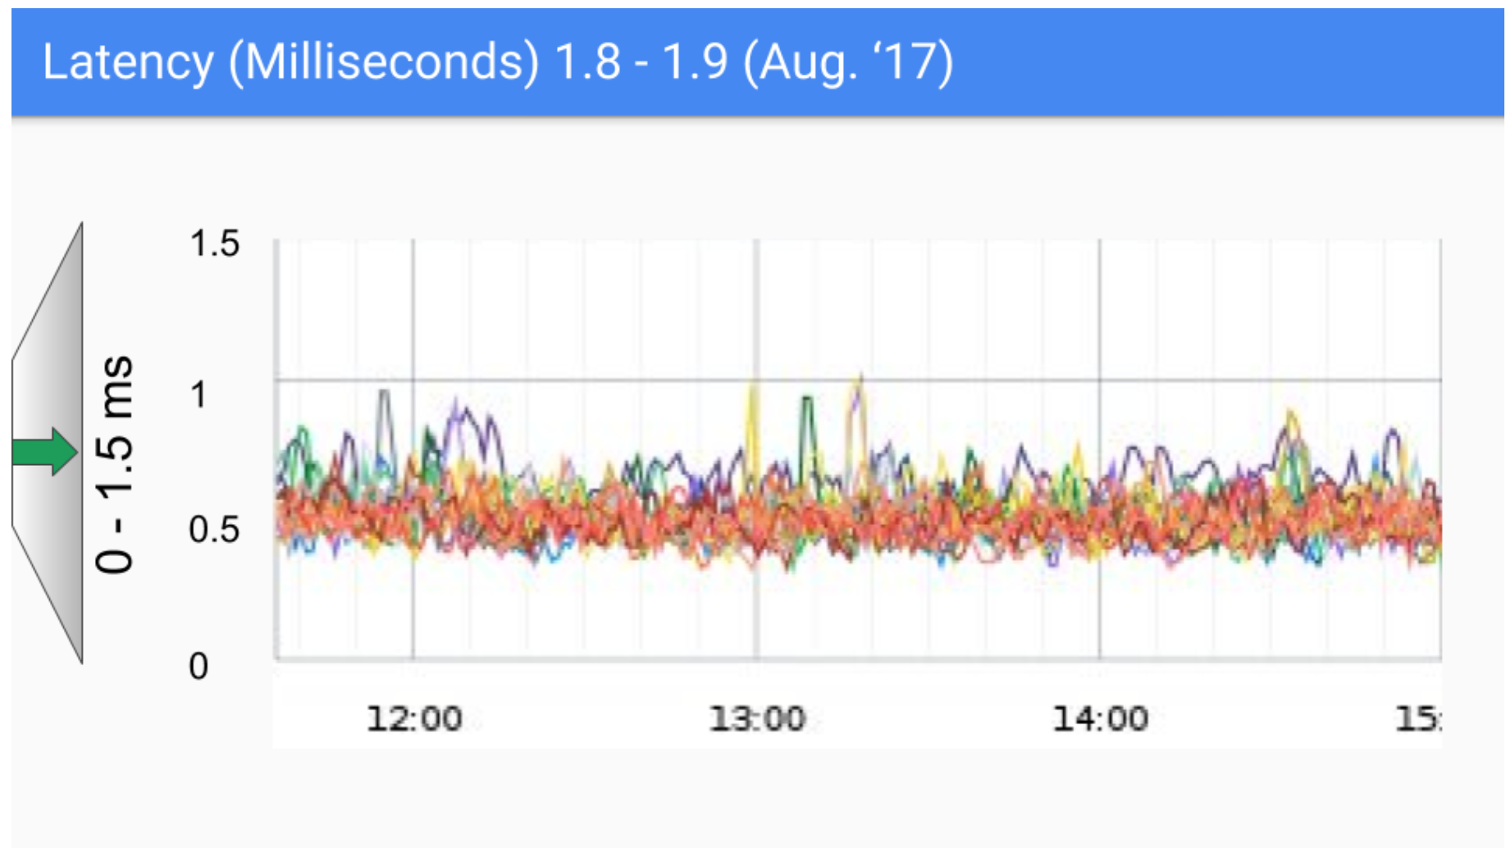
Latency: 1.8 – 1.9

Slide 33
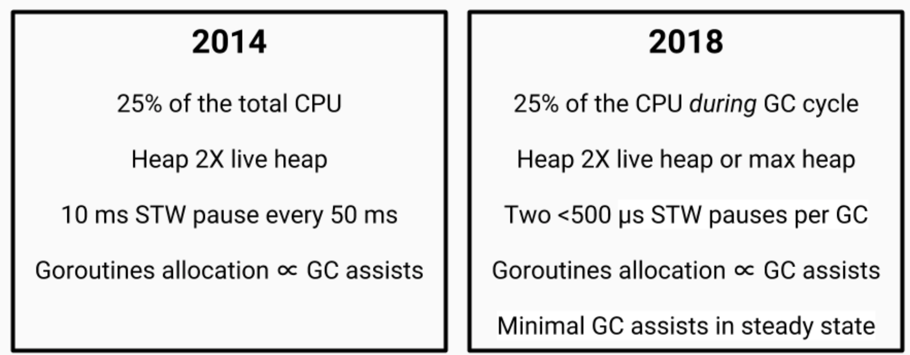
SLOs then and now

Slide 34
Request Oriented Collector(面向请求的回收器)
优势：
Go目前很大一个应用场景是接受一个请求, 开一个协程, 进行处理, 处理完后协程回收
大大减少了对象的publish，大部分对象在请求结束后就回收
劣势
需要写屏障一直开启
开启ROC的Go编译器使得编译速度降低了30%-50%, 一些性能测试中, 也降低了30%多
在4-16核的小机器上, 这些性能损失是不可接受的
在128核以上, ROC的扩展性带来的好处大于写屏障带来的性能损失

Slide 35
Generational GC
大部分对象都是短生命周期
每次只要扫描一小部分Heap
通常是两个代：Young && Old
Minor GC存活的对象Copy到老年代
Minor GC存活对象，通过Eden区暂存，多次存活对象Copy到老年代

Slide 36
Generational GC劣势
Write barrier always on
Escape analysis and value-orientation：大部分短生命周期对象都直接分配在栈上

Slide 37
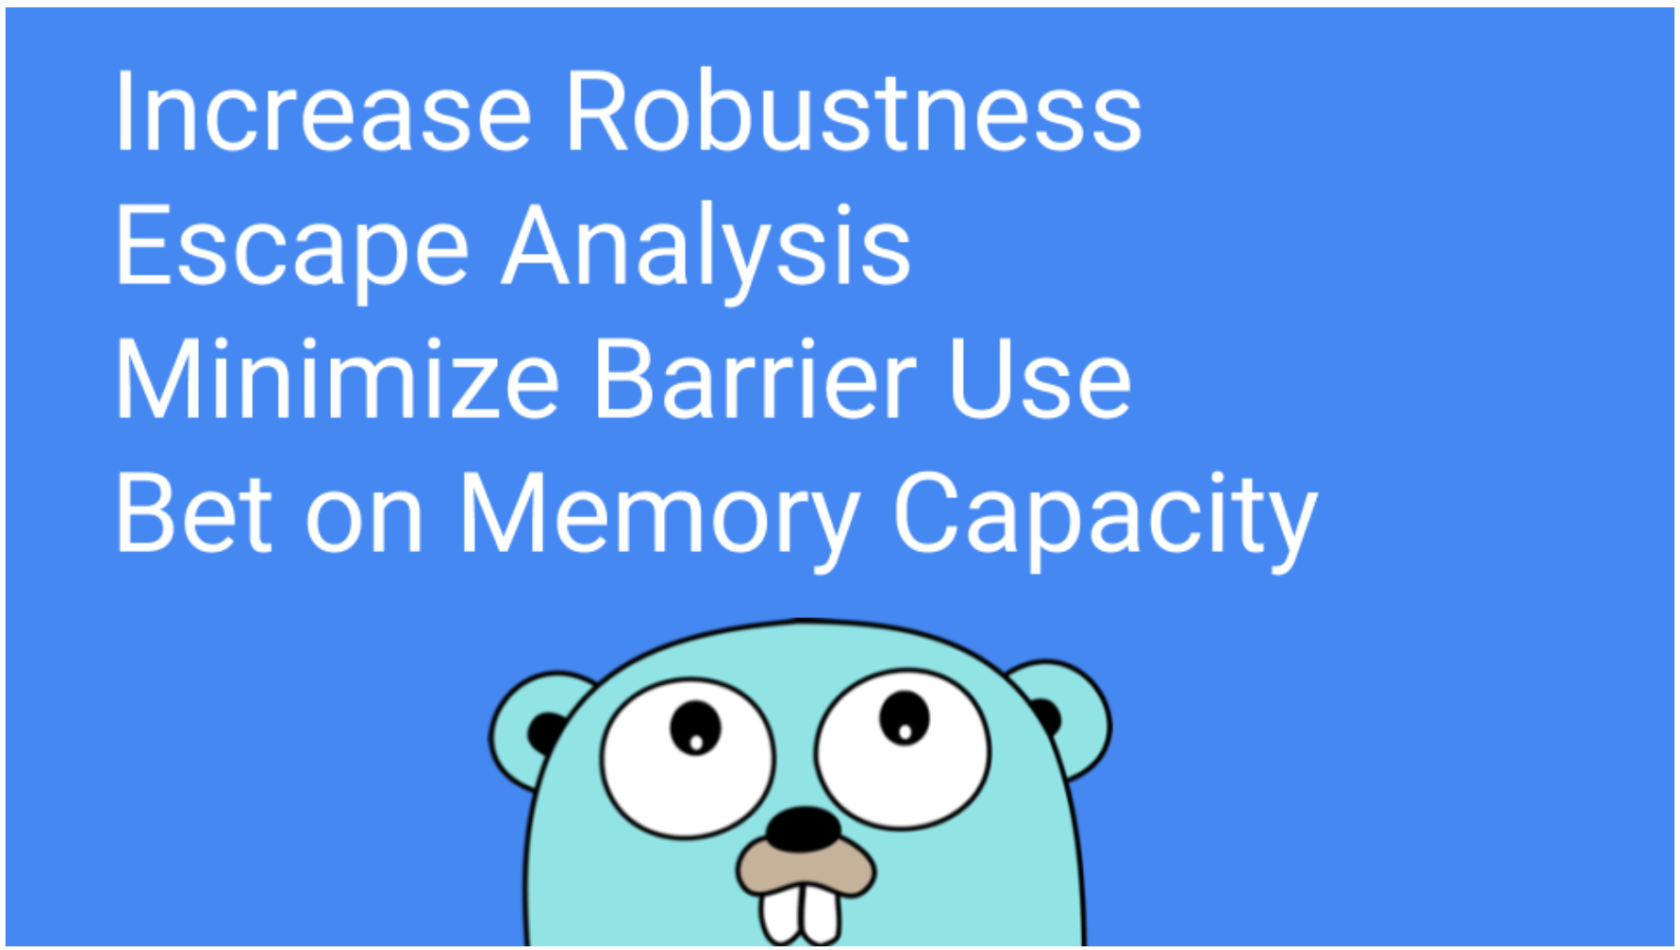

Slide 38
THANK YOU

